Slide 1
Sequential Line Search for Efficient Photo Parameters Tweaking
SimpleLazyTeam
Yueh-Han Chuang
Ke Han
Yen-Hsiang Huang
Han-Yu Lee
Jiayi Wang

Slide 2
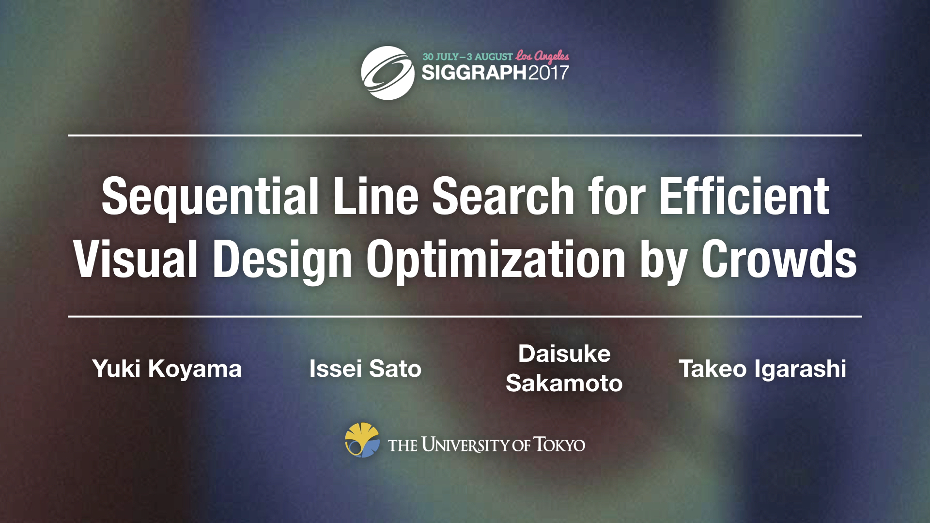
Sequential Line Search for Efficient Visual Design Optimization by Crowds

Slide 3
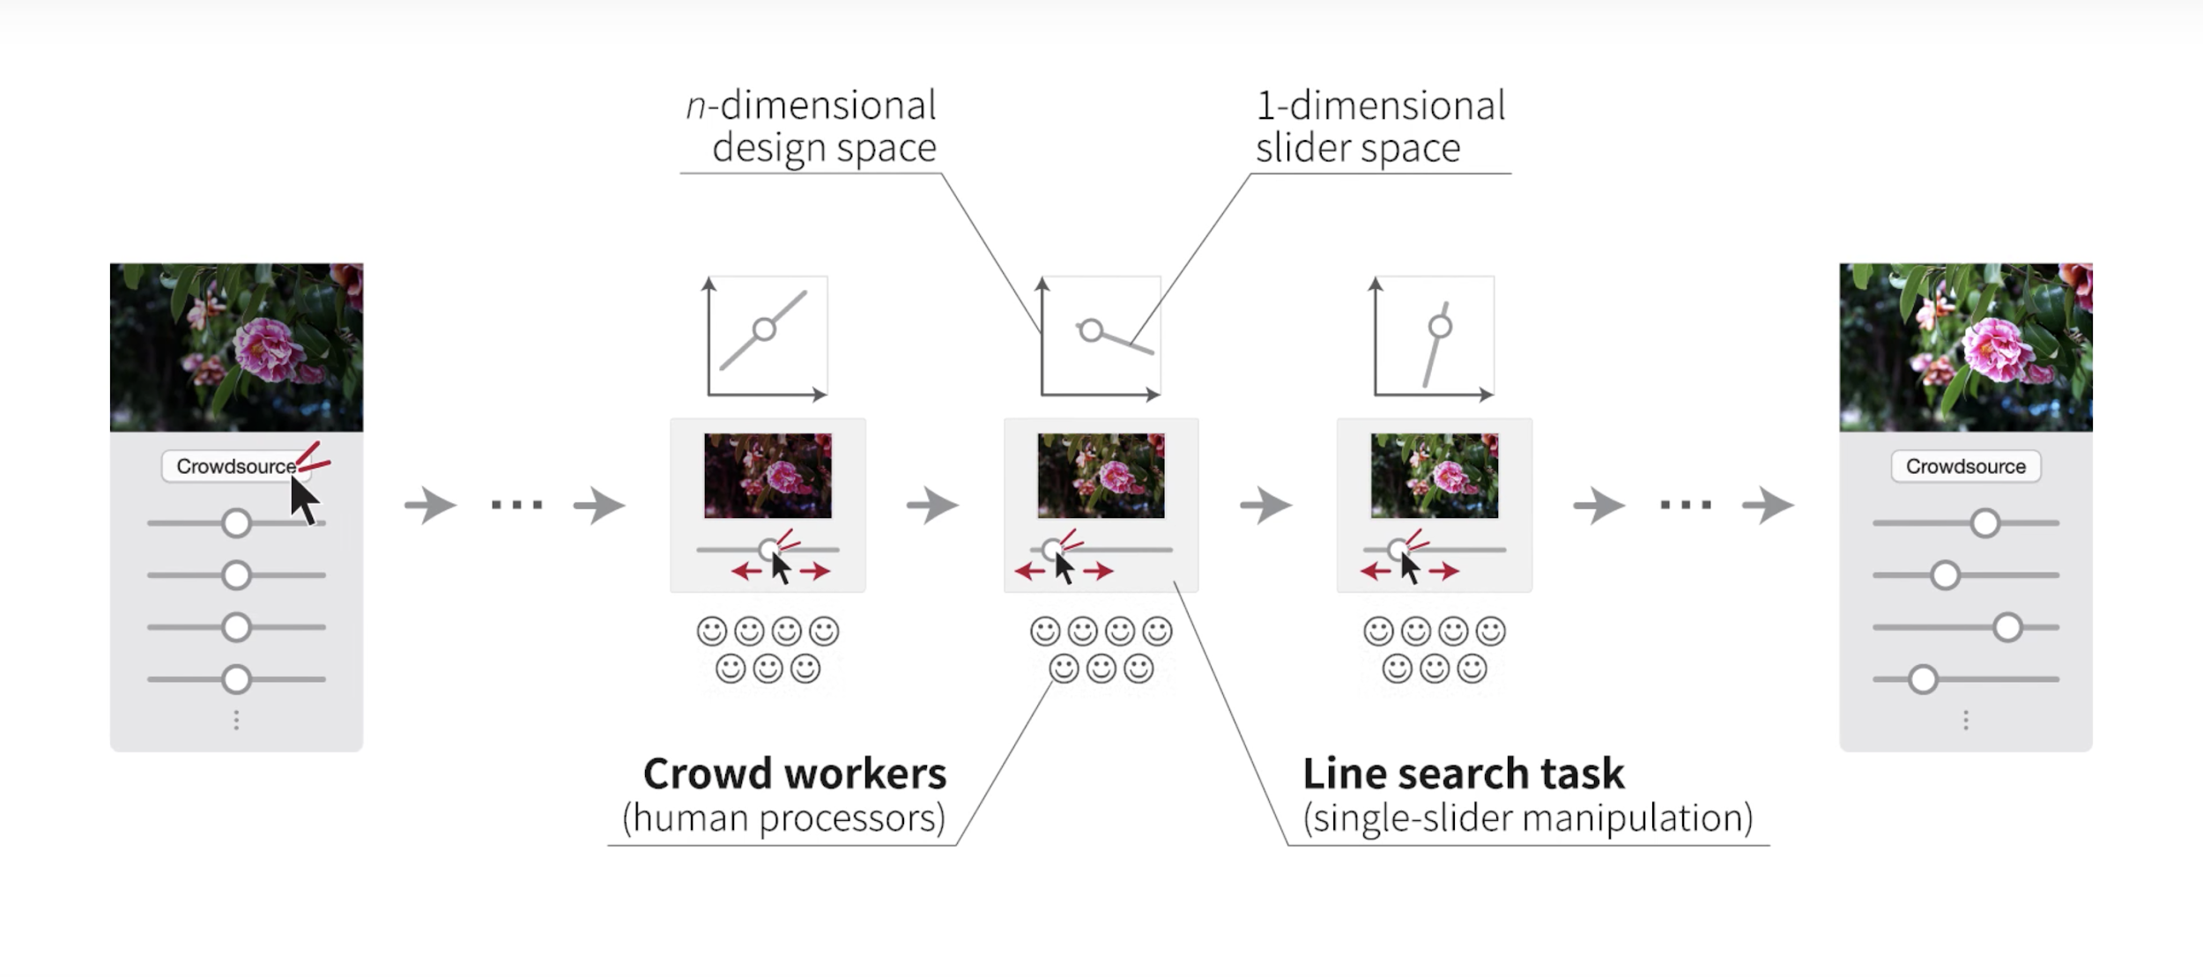
Goal
Decomposes parameter tweaking task into a sequence of one-dimensional line search queries.
Notes:
Brightness
Contrast
Saturation
Ambiance
Highlights
Shadows
Warmth

Slide 4
Unit Technologies
Mathematic Sequential line search using bayesian optimization
Start with random parameter slide bar
Get observation from users
Estimate the best-expected-improving position x^{EI} based on current observations
Construct a slide bar by current best position x⁺ and best-expected-improving position x^{EI}
GUI and rendering User interface
Slide bar window
File I/O system(Open File, Finish, Export Image)
Image rendering
Image decoder
Image filter
Image encoder

Slide 5
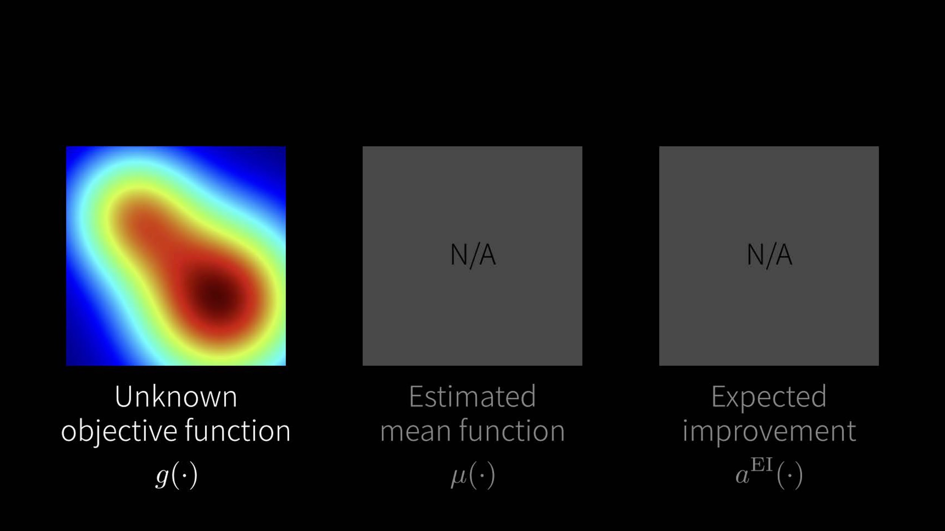

Slide 6
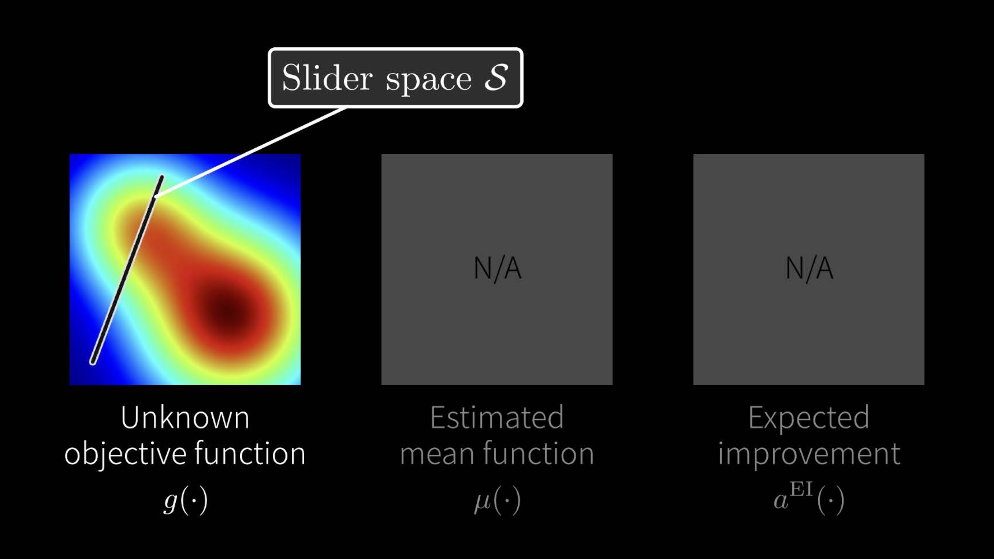

Slide 7
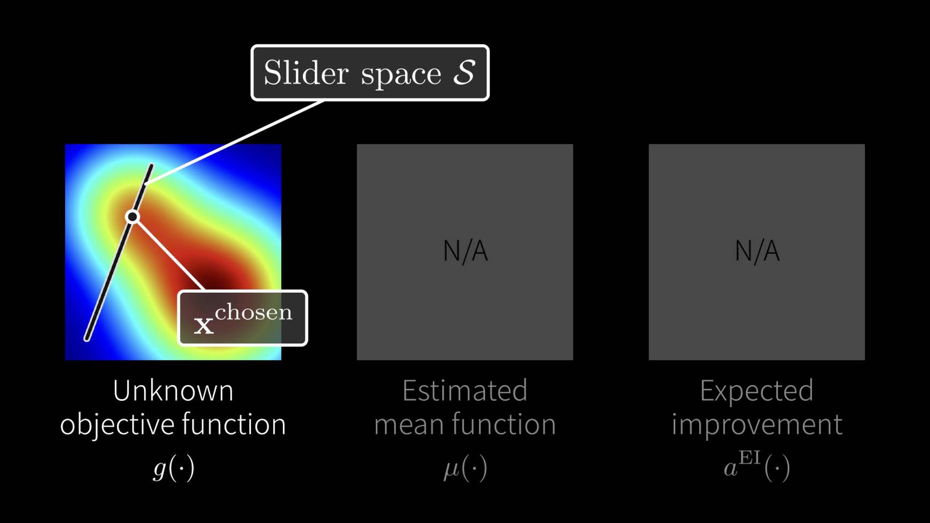

Slide 8
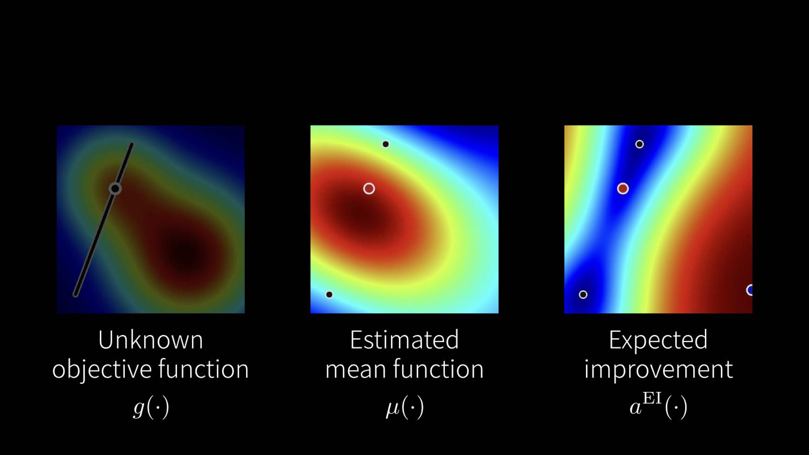

Slide 9
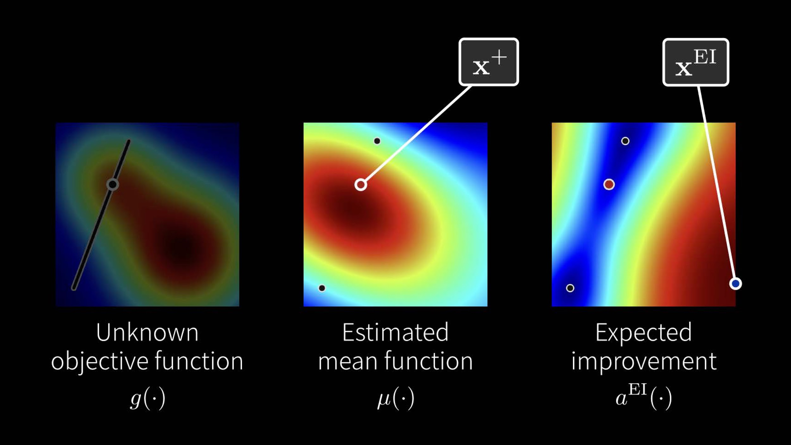

Slide 10
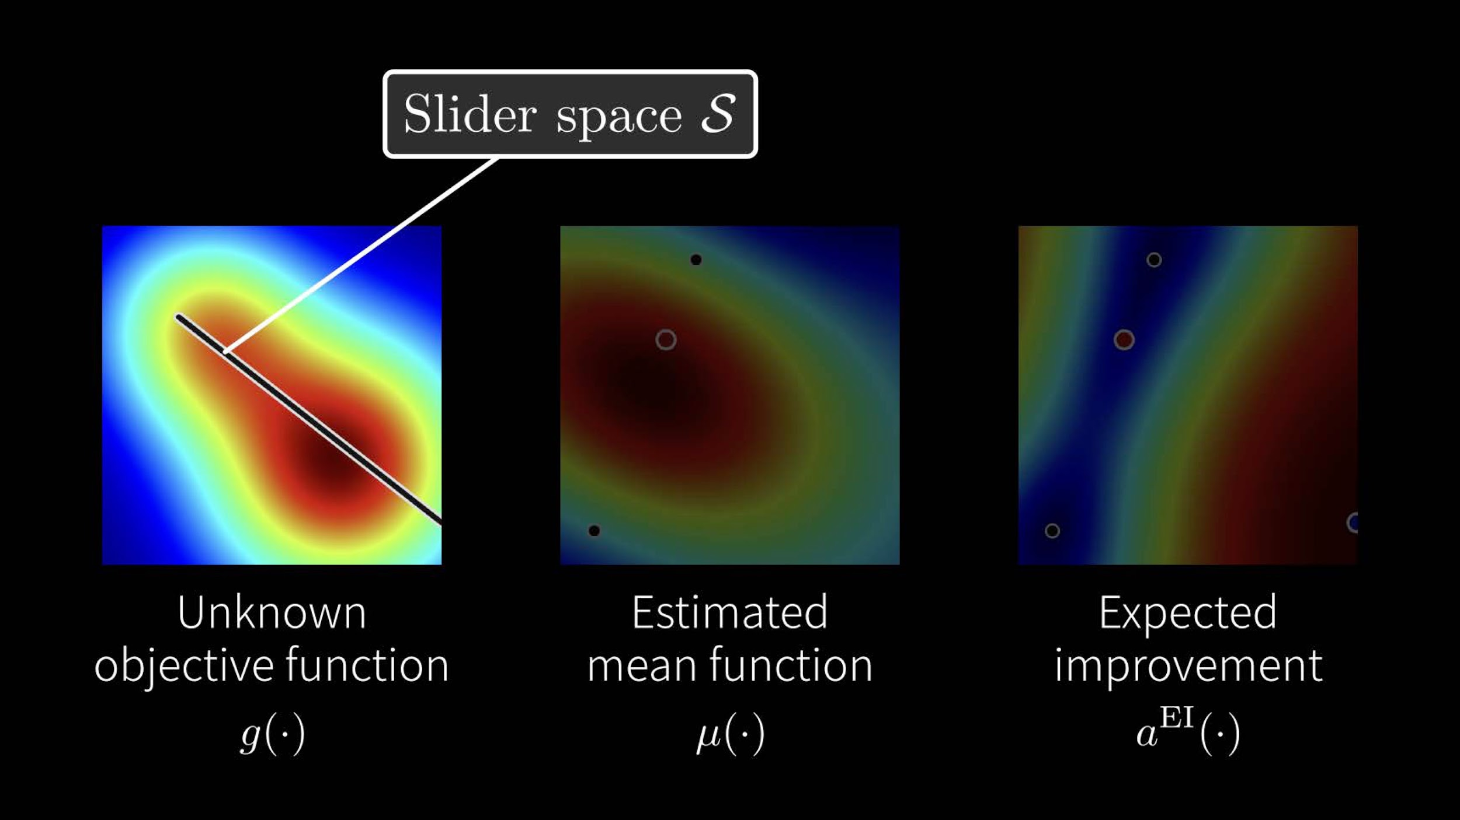

Slide 11
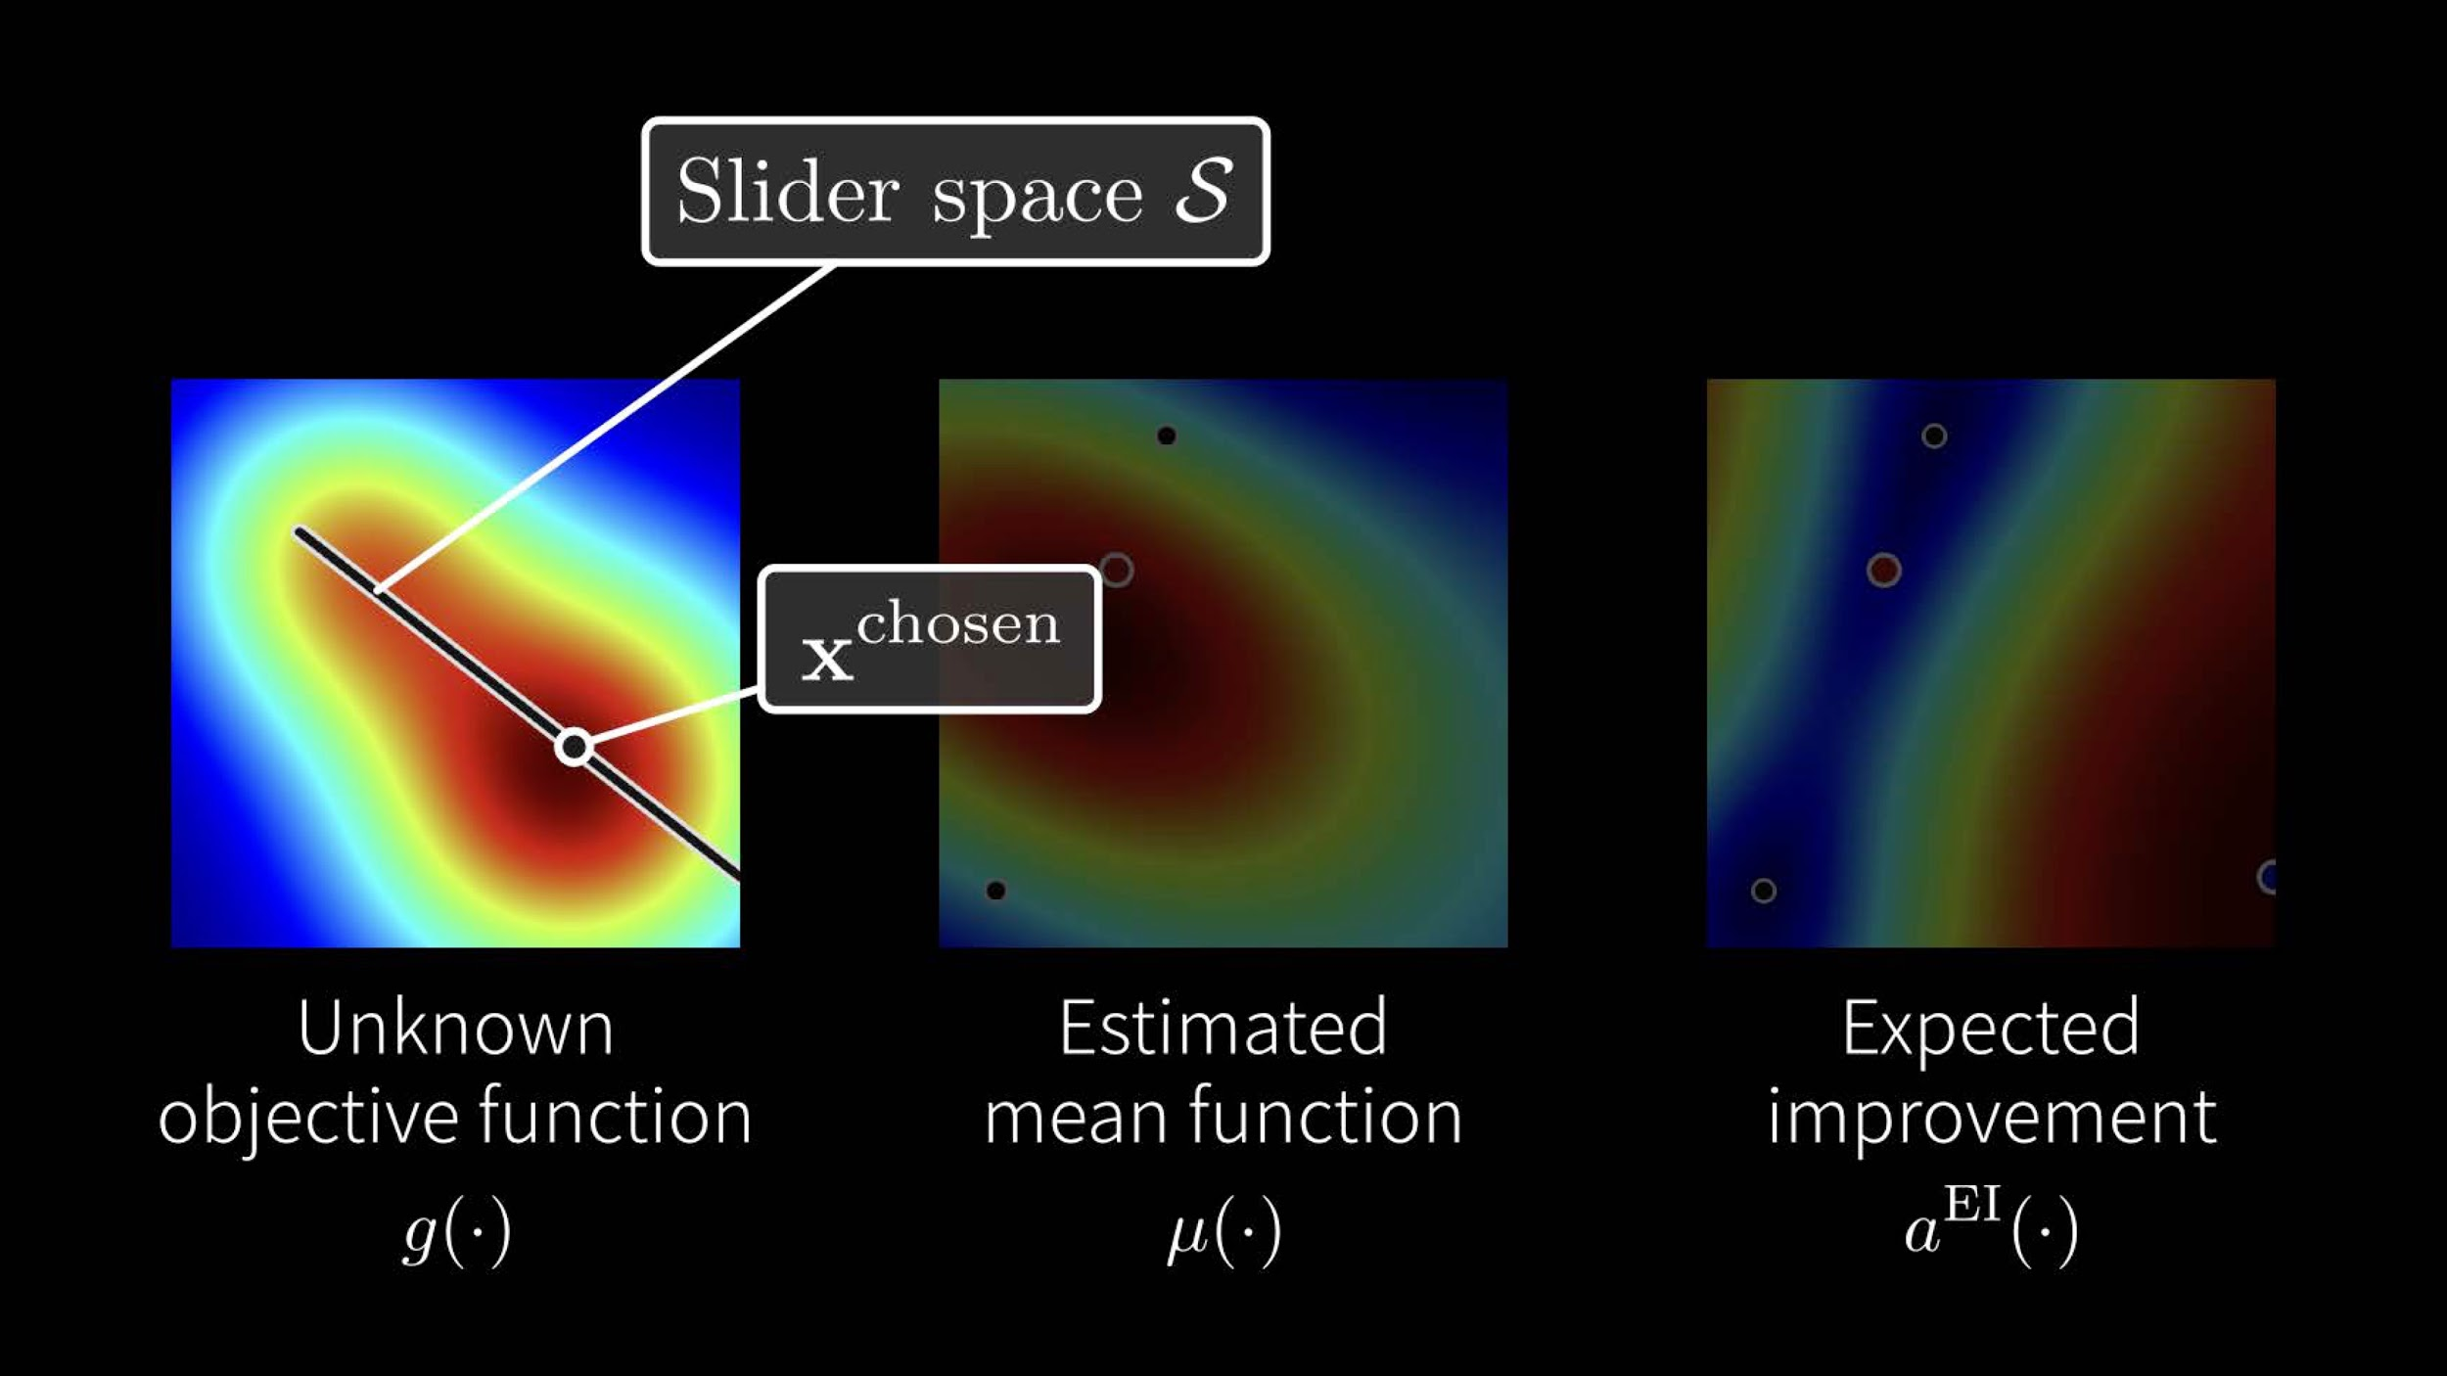

Slide 12
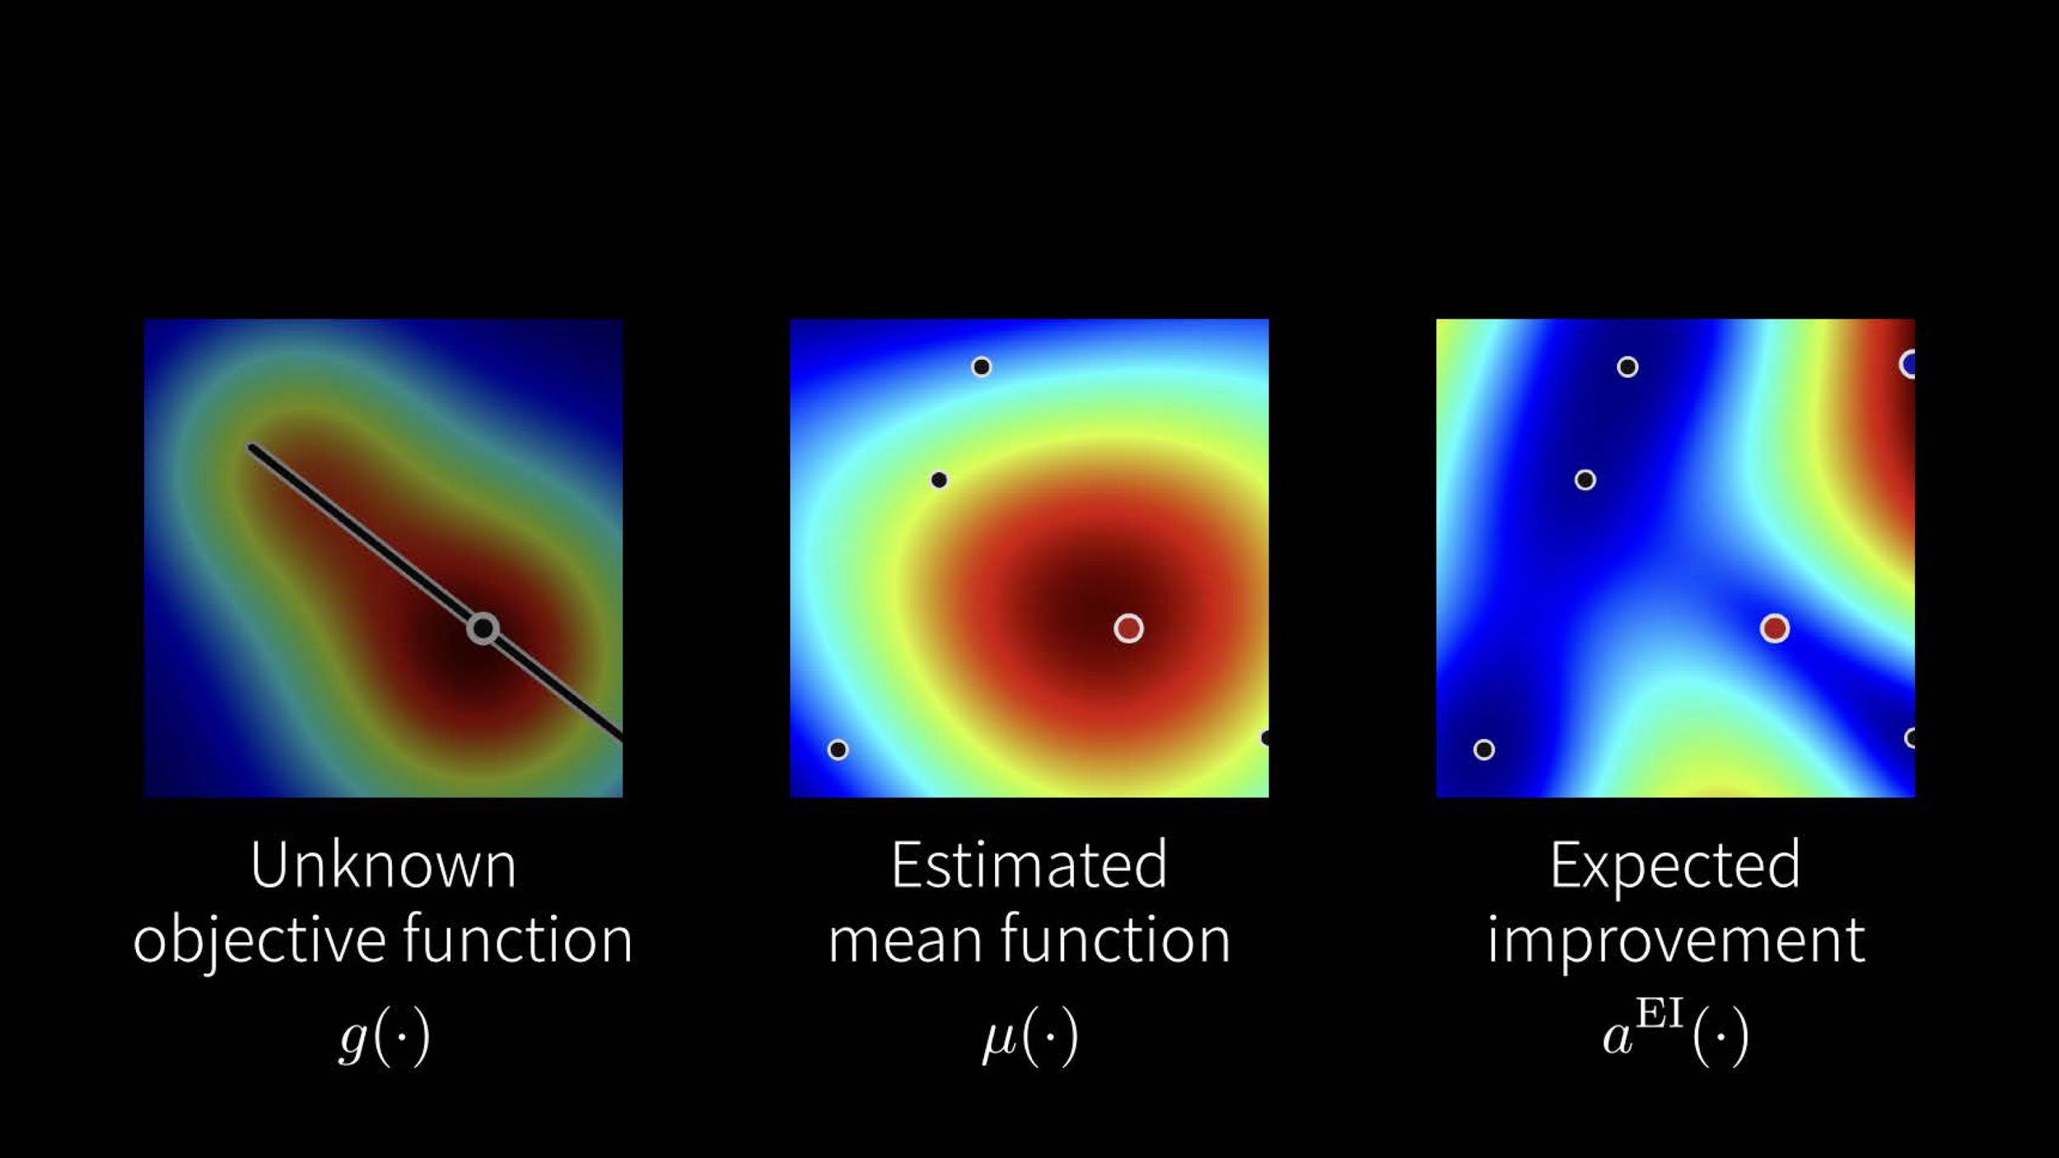

Slide 13
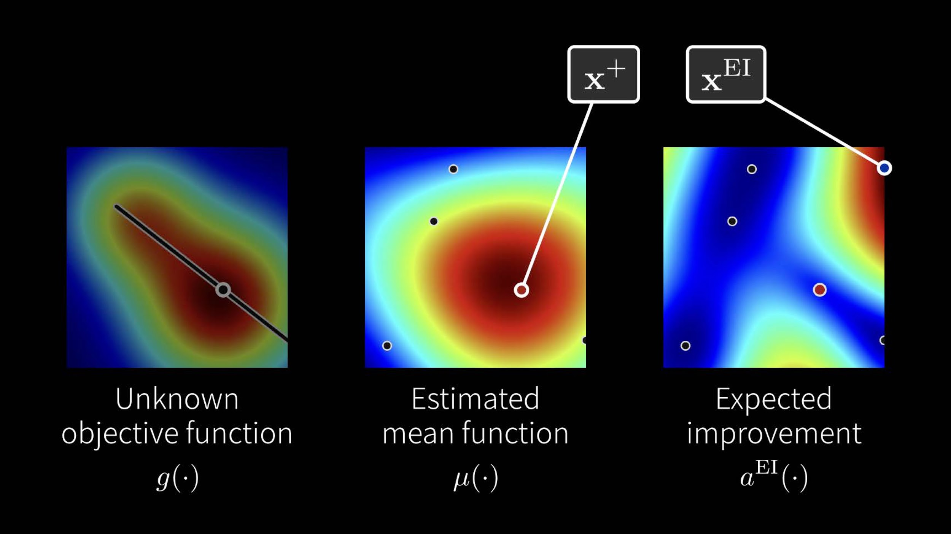

Slide 14
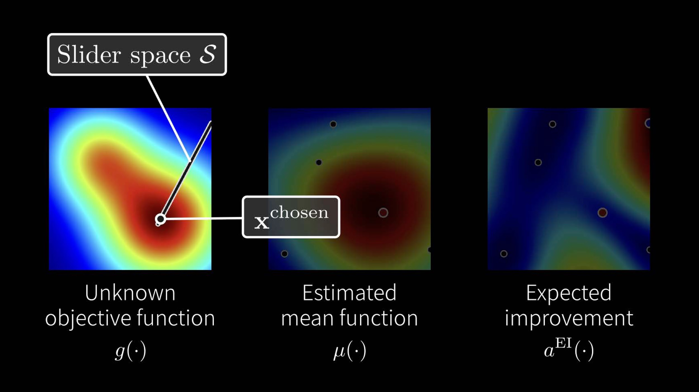

Slide 15
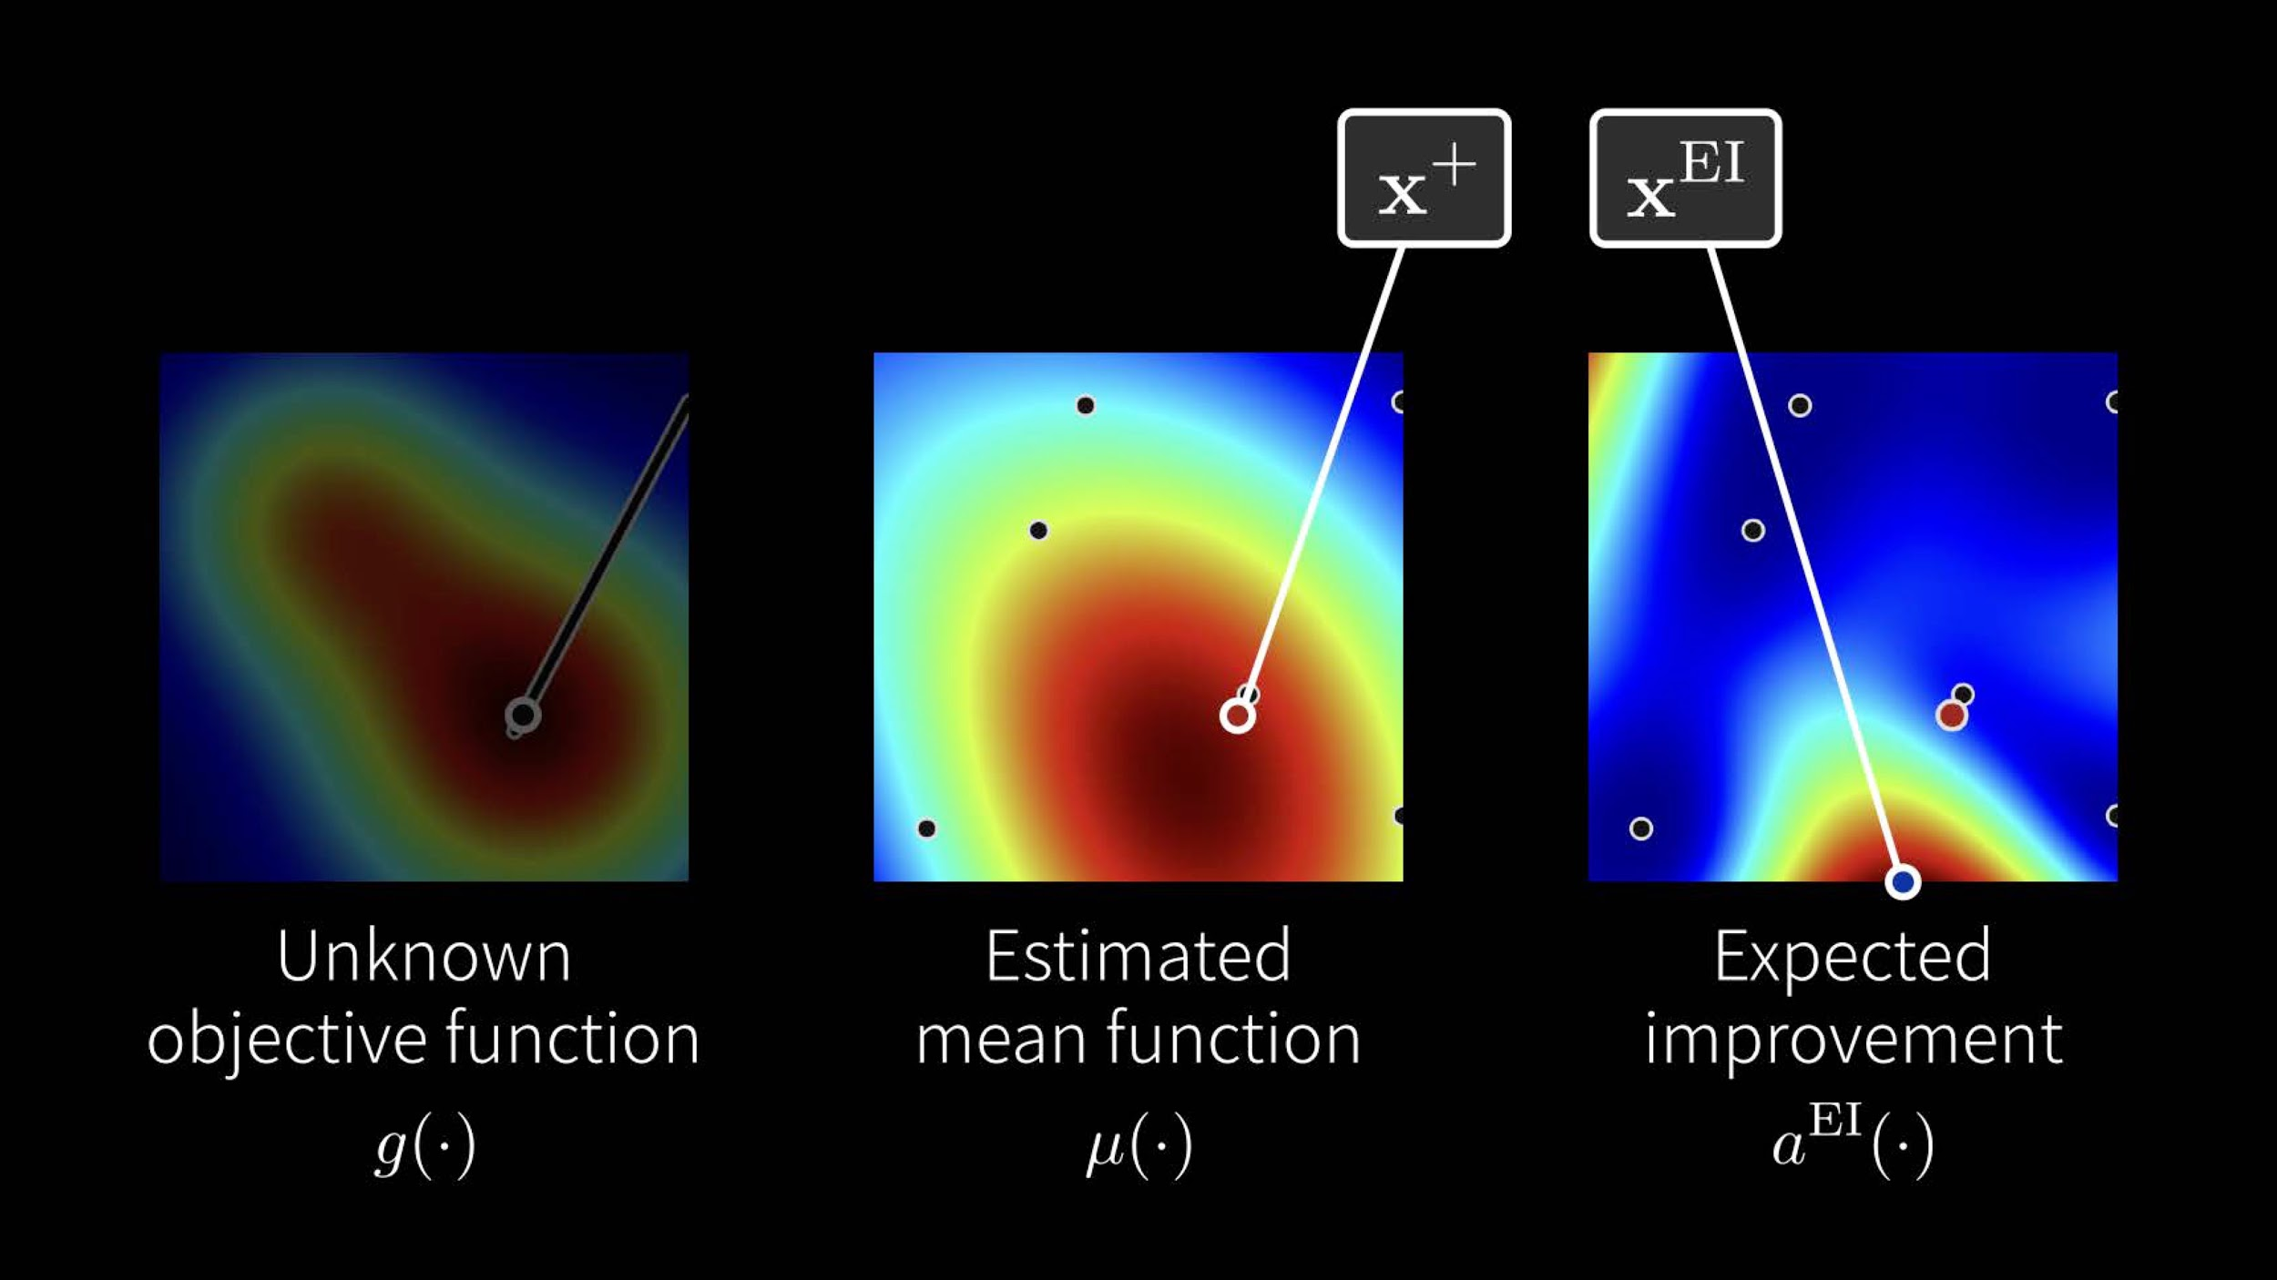

Slide 16
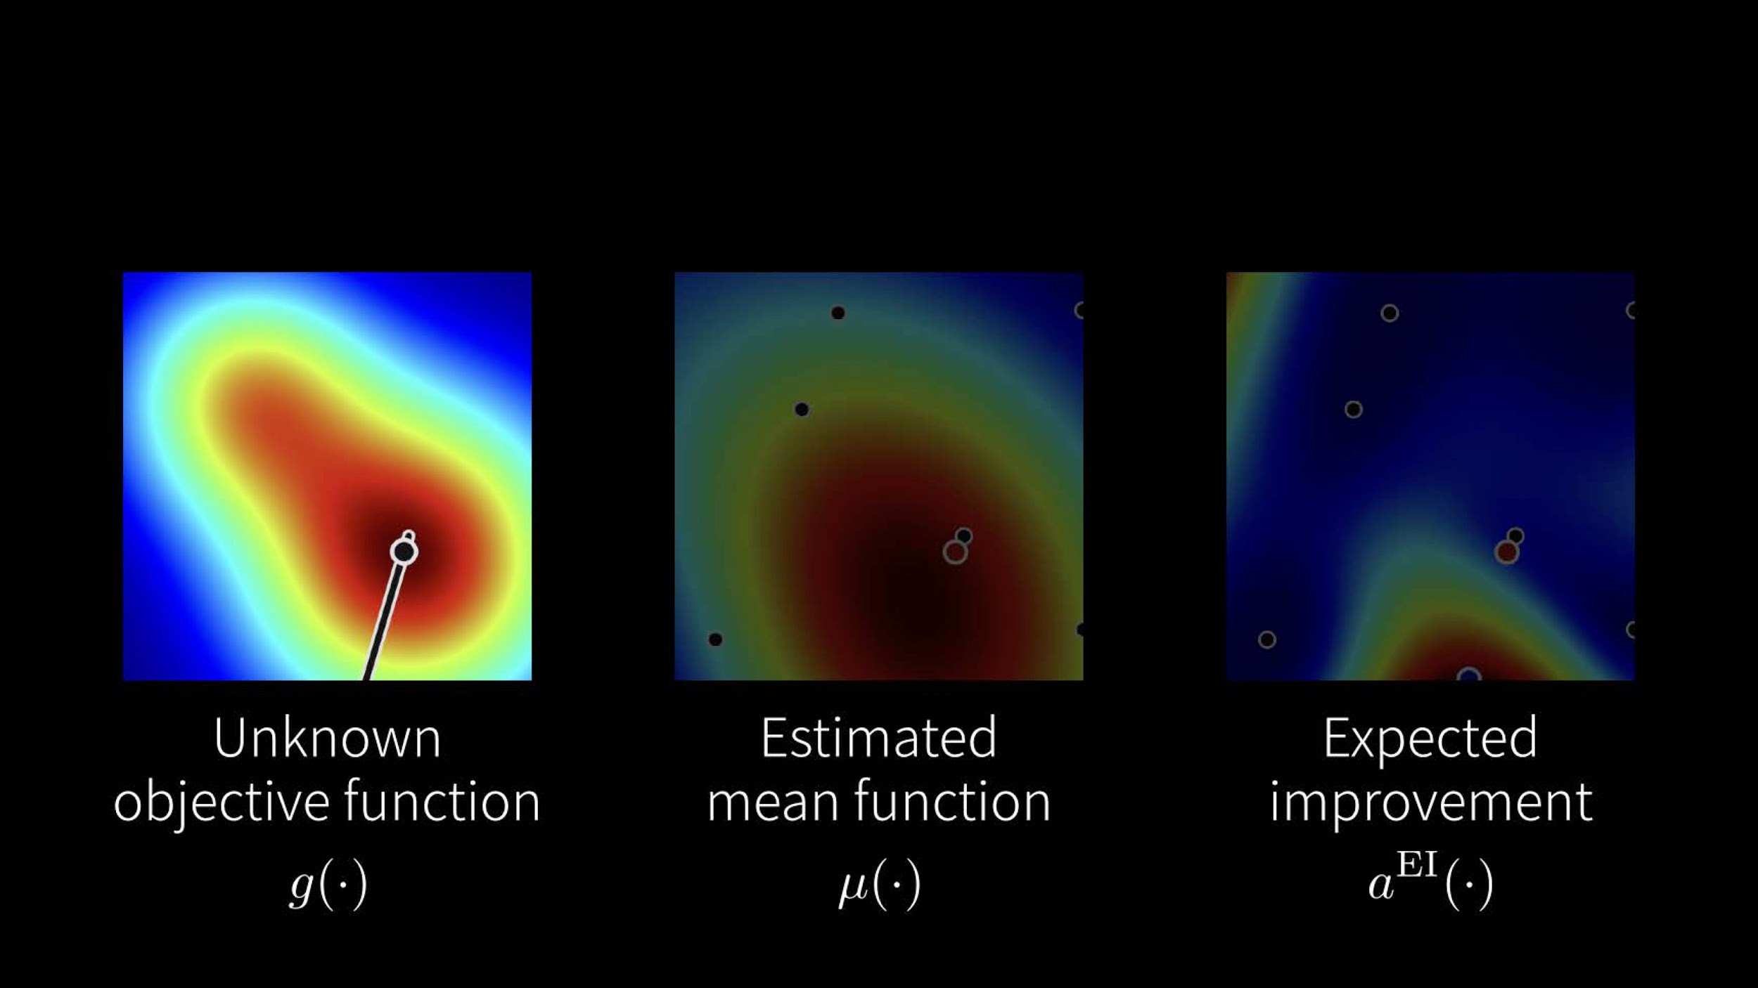

Slide 17
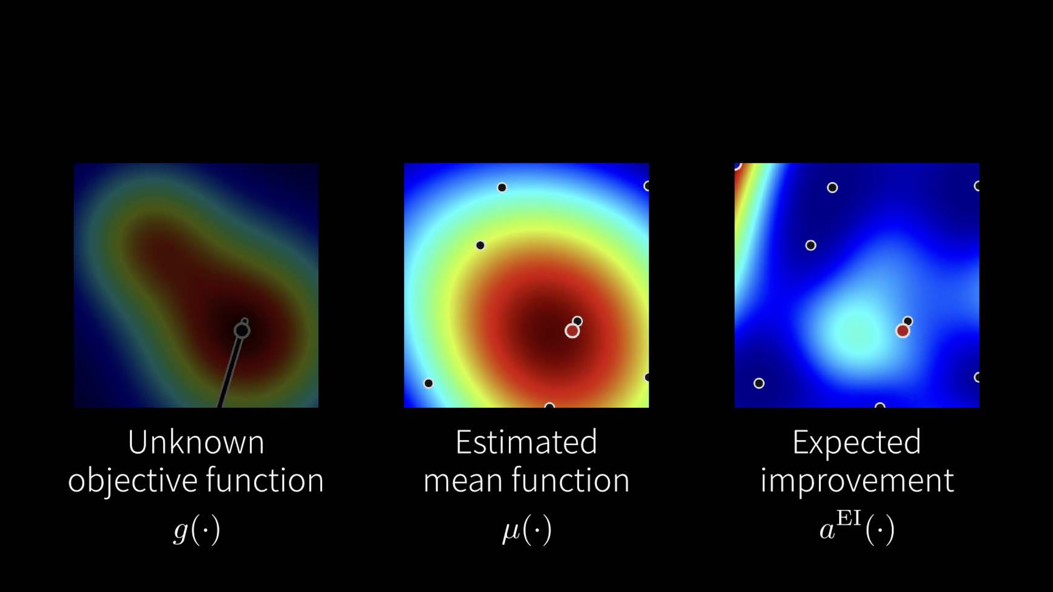

Slide 18
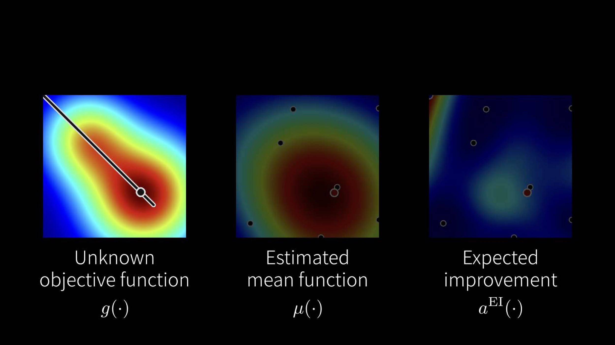

Slide 19
Unit Technologies
Mathematic Sequential line search using bayesian optimization
Start with random parameter slide bar
Get observation from users
Estimate the best-expected-improving position x^{EI} based on current observations
Construct a slide bar by current best position x⁺ and best-expected-improving position x^{EI}
GUI and rendering User interface
Slide bar window
File I/O system(Open File, Finish, Export Image)
Image rendering
Image decoder
Image filter
Image encoder

Slide 20
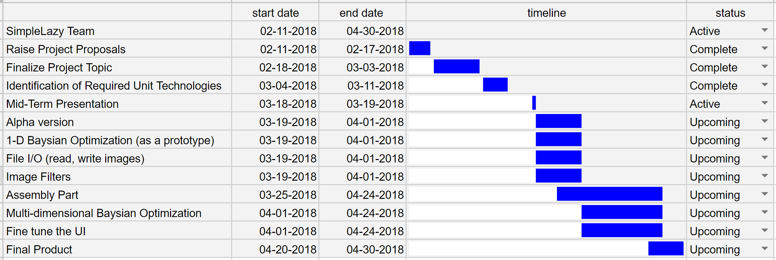
Gantt Chart

Slide 21
Reference
Yuki Koyama, Issei Sato, Daisuke Sakamoto, and Takeo Igarashi. 2017. Sequential Line Search for Efficient Visual Design Optimization by Crowds. ACM Trans. Graph. 36, 4, pp.48:1--48:11 (2017). (a.k.a. Proceedings of SIGGRAPH 2017)

Slide 22
Thank you :)
SimpleLazyTeam
Yueh-Han Chuang
Ke Han
Yen-Hsiang Huang
Han-Yu Lee
Jiayi Wang

